Slide 1
COMPUTERS & CODING
Algorithms & Apps
Module 6.3

Slide 2
Algorithms?
.
Image source: www.pixabay.com
Notes:
Can you remember the session when you were writing code, or instructions, for a person to make it through the maze / obstacle course?
To make a computer do something, we have to write a computer program using very specific instructions, or procedures. We have to tell the computer, step by step, exactly what we want it to do.
The computer can then "execute" or “run” the program, by following each step in the procedure mechanically.
When we tell the computer what to do, we also get to choose how it's going to do it. That's where computer algorithms come in.
An algorithm is a set of rules that tells you what to do in a given set of circumstances, for instance ‘If the traffic light is red, I stop’. Creating an algorithm simplifies decision-making and increases the efficiency of a procedure.

Slide 3
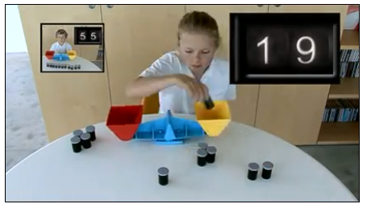
Sorting and Searching
http://csunplugged.org/sorting-algorithms/
Video: Sorting Algorithms
Notes:
Computers are very efficient at managing large amounts of data! Many clever algorithms have been written for managing data, such as putting data in order (SORTING), or searching for particular data. Some sorting and searching algorithms are faster or more efficient than others, and newer and more efficient algorithms are still being invented!
Why would we need such algorithms? Imagine if you had the test scores of 1000 students and wanted to find the marks of the top 5 students. Going through all 1000 marks one by one without a computer would take a lot of time. A searching algorithm could perform this task for you quickly.
Video Link: https://youtu.be/cVMKXKoGu_Y

Slide 4
Bubble Sort Algorithm
The Bubble Sort Algorithm compares elements (numbers) next to each other, and keeps swapping them until they are in order from lowest to highest.
Example:
First Pass: ( 5 1 4 2 8 ) –> ( 1 5 4 2 8 ), Algorithm compares the first two elements, swaps, since 5 > 1. ( 1 5 4 2 8 ) –> ( 1 4 5 2 8 ), Compares next two, swaps, since 5 > 4 ( 1 4 5 2 8 ) –> ( 1 4 2 5 8 ), Compares next two, swaps, since 5 > 2 ( 1 4 2 5 8 ) –> ( 1 4 2 5 8 ), Compares, elements are already in order (8 > 5), so no swap.
Second Pass: ( 1 4 2 5 8 ) –> ( 1 4 2 5 8 ), Already in order, no swap. ( 1 4 2 5 8 ) –> ( 1 2 4 5 8 ), Swaps, since 4 > 2 ( 1 2 4 5 8 ) –> ( 1 2 4 5 8 ), Already in order, no swap. ( 1 2 4 5 8 ) –> ( 1 2 4 5 8 ), Already in order, no swap.
Now, the numbers are already sorted, but our algorithm does not know if it is completed! The Bubble Sort algorithm needs one whole pass without any swaps to know it is sorted. So it will run a third time, and there will be no swaps, and the process will end.
Reference: https://en.wikipedia.org/wiki/Bubble_sort
Notes:
Bubble Sort is the simplest sorting algorithm that works by repeatedly swapping the adjacent elements if they are in wrong order. The slide shows an example of the Bubble Sort algorithm sorting a set, or “array” of 5 numbers from smallest to largest.
Let’s try it out!
Activity 6.3.1:
Ask all students to stand up and form a line. Next, ask the students to sort themselves into height order, using only the Bubble Sort Algorithm. They will need to choose which end they are starting at, then compare the two adjacent people, decide if they swap, and repeat along the line. Then, repeat the process, until the line of students is in height order.
Note: You could form 2 or 3 lines for larger groups, perhaps making it a competition to see which group can sort into height the fastest.

Slide 5
Algorithms are Everywhere!
Magic
Data Analysis
Mathematics
Medicine
The stock market
Science
Climate change modelling
Video games
Computing
Google (search engine)
Notes:
Algorithms are everywhere! What examples can you think of, where it may be useful to have an algorithm helping to sort, search, or manage data?
Optional extension : Video “What’s an algorithm By David J Malan”
https://www.youtube.com/watch?v=8_eF-pnZrxo

Slide 6
Algorithms and Magicians
Video: 21 Card Trick
https://youtu.be/KpMWlhrYO4A
Image source: www.pixabay.com
Notes:
The skills you need to be a great stage magician are exactly the same as those you need to be a great computer scientist: computational thinking.
Magic tricks, especially card tricks, often use algorithms! Let’s take a look at a magic trick called the “21 card trick” and see if we can observe the algorithm.
Perform the 21 card trick with a student volunteer, demonstrating it to the group.
Next, perform the trick with a second student volunteer, showing the steps on the next slide to explore the algorithm.

Slide 7
21 Card Trick
STEPS:
Have the volunteer shuffle a modified deck of cards (use 21 cards).
Deal out a row of three cards face up from left to right.
Repeat this another six times, so there are 21 cards laid out in 3 equal lines.
Have the volunteer mentally select one of the cards. They can show/tell others.
The volunteer does not tell you the card, but points to / tells you what line it is in.
Collect a line of cards that DOES NOT have the volunteer’s card, stack it up.
Collect the line that DOES have the volunteer’s card, place this on the first stack.
Collect the remaining line of cards, and stack it on top of the other cards.
NEXT:
Repeat steps 2 and 3.
Ask the volunteer to point to the line their card is in.
Repeat steps 6, 7, and 8.
Repeat steps 2 and 3.
Ask the volunteer to point to the line their card is in.
Repeat steps 6, 7, and 8.
Repeat steps 2 and 3.
The middle card in the middle line is the volunteer’s chosen card!
Source: http://kidsentertainerhub.com/the-21-card-trick/
Notes:
Ask for a second volunteer and perform the card trick again whilst explaining the algorithm for the trick.
You’ll see some “repeats” and when to “stop”.
There are many ways to write the Algorithm for this magic trick. It could be written like this:
- Perform Steps 1 to 8 once.
- Then, repeat Steps 2 and 3 once.
- Ask volunteer which line their card is in.
- Then, repeat Steps 6, 7, and 8 once.
- Then, repeat Steps 2 and 3 once.
- Ask volunteer which line their card is in.
- Then, repeat Steps 6, 7, and 8 for the final time.
- Then, repeat Steps 2 and 3 for the final time.
- Select the middle card from the middle line. End.

Slide 8
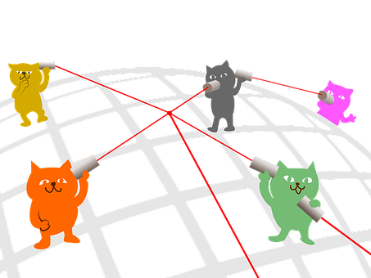
Algorithms and Networks
Image Source: http://www.pixabay.com
Notes:
Algorithms have important applications in networks.
A network is a group or system of interconnected people, or things. Networks are everywhere in modern society, connecting one place to another.
Some examples are: roads, water supply, electricity, telephone wires. What examples of networks can you think of?
Computer networks exist at many levels, ranging from the microscopic connections between the computer hardware inside computers, through to the satellites that link the internet around the world.
People who build networks often need to work out the most efficient way to make connections, which can be a difficult problem. Imagine having 10, 000 homes to connect to the electricity network! That could be very costly and expensive. It is important to work out the most efficient way to connect each home to minimise costs. Algorithms can be used to identify the most efficient networks.

Slide 9
Algorithms for Apps
Apps can be:
Desktop
Mobile
Web
Algorithms are used to instruct how an app works
Image Source: https://www.lifewire.com/what-are-apps-1616114
Notes:
The word "app" is an abbreviation for "application." An app is a software program that can run on a range of platforms, for example, through a web browser or even offline on your computer, phone, tablet or any other electronic device. Apps may or may not have a connection to the internet.
An app is usually a program you download / buy to use for a specific purpose, rather than core software that makes your computer work.
There are three main types of apps: desktop, mobile, and web.
Desktop apps are usually more complex than mobile apps, and have more functions and features. Desktop apps (and some web based apps) are designed to be used with a mouse and keyboard, and large screen display, whereas simpler mobile apps are intended to be accessed on a small screen, with a finger or stylus pen.
Recap: algorithms are a set of rules that serves as the instructions the computer uses in order to complete an assigned task.
So, to design an app, programmers need to write algorithms, but first, need to decide: what the purpose of their app is, what it needs to do in specific circumstances, how the program should react in these circumstances + more.
For example, what happens if the user of the app clicks “yes” or “no” on their screen? Is a message is displayed, does a sound play, or something else?

Slide 10
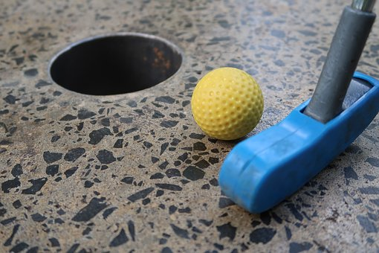
App Inventor Challenge
Learn to design your very own App using MIT’s App Inventor!
Create a mini golf game app!
Image Source: http://www.pixabay.com
Notes:
To learn how to design apps we will explore the MIT App Inventor. We will write algorithms to create a fun, playable mini-golf app.
We will use computers, and work in small groups. Let’s take a look at the key features of the MIT App Inventor before we get started.

Slide 11
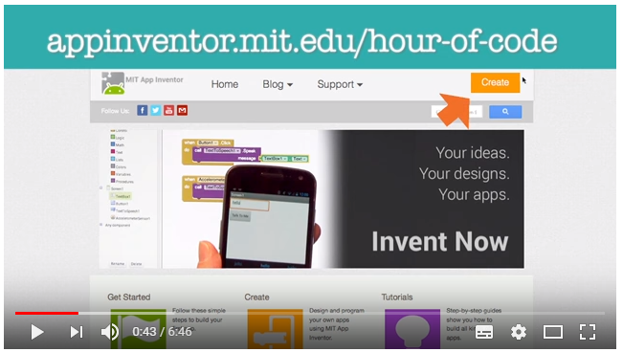
MIT App Inventor
Video Tutorial: Talk To Me (Part 1) MIT App Inventor Tutorial
https://youtu.be/Vdo8UdkgDD8
Notes:
This video tutorial will step through how to create a new program in the MIT App Inventor, and show how to create a simple example app called “talk to me”.
A couple of things to think about before we start designing our own app:
We can use an android mobile phone, or tablet, to test out our app while we are designing it. Or, we can use an ‘android emulator’ on the internet.
We’ll need an email account to use the MIT App Inventor, this could be a school account, or, you could set up a free online google (Gmail) account, to do this visit: https://accounts.google.com/SignUp?hl=en

Slide 12
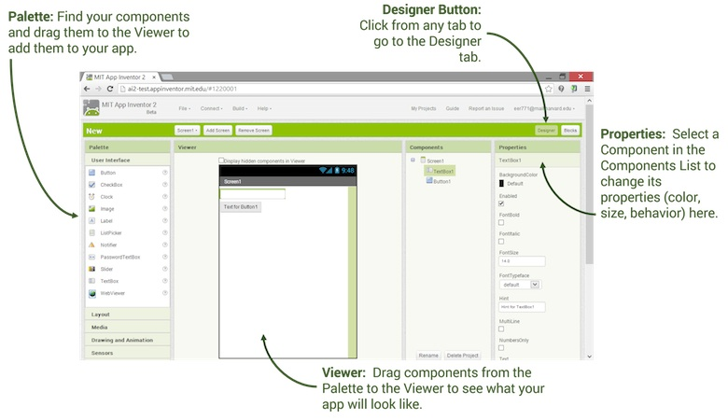
MIT App Inventor: Designer Editor
Image Source: http://appinventor.mit.edu/explore/designer-blocks.html
Notes:
There are two key windows to work in, DESIGNER, and BLOCK.
MIT App Inventor: Designer Editor:
Think of a component as a “piece” of your app. A component may be an image, some text, or something else.
The designer editor allows you to add different “components” to your app. These can be on-screen (visible to the user) and off-screen.
The ‘palette’ menu on the left-hand side of the designer screen lists categories of components, which can be added to your app.
The ‘viewer’ is where you can see and preview the components you’ve chosen for your app.
The ‘components’ menu allows you to select a component to work on.
The ‘properties’ menu on the right-hand side of the designer screen allows you to modify a component you have selected to work on (for example, changing the colour of a selected text component).

Slide 13
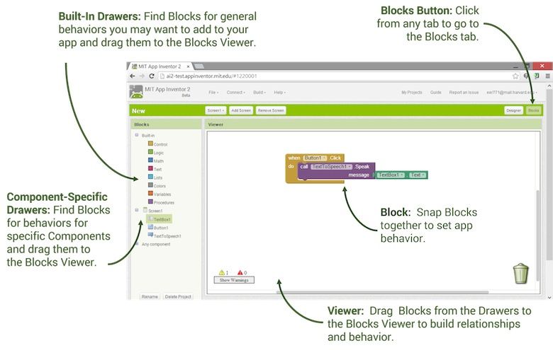
MIT App Inventor: Block Editor
Image Source: http://appinventor.mit.edu/explore/designer-blocks.html
Notes:
MIT App Inventor: Block Editor:
The blocks editor is used to program the app's behaviour.
The blocks used are just like the BLOCKLY coding we did in the previous session (Minecraft and Flappy Birds exercises).
The “blocks” menu has built in blocks for behaviours, and you can drag these into the ‘blocks viewer’.
The blocks are broken into different types by colour in menu. Some components have their own specific blocks. You can explore these when you are designing your app.
Just like in BLOCKLY, the blocks need to join together to create the behaviour, or action. You can decide “what happens if” a certain action is undertaken by the user of the app, for example, “when the space bar is pressed”… “display the message ‘well done’”.

Slide 14
The Challenge
Using your tutorial notes, try out App Inventor by creating a Ball Bounce Game.
Make sure you have an android device or android emulator connected so you can test as you go!
When you have completed the basic game, see if you can make a Mini Golf game using the suggestions on the tutorial notes!

Slide 15
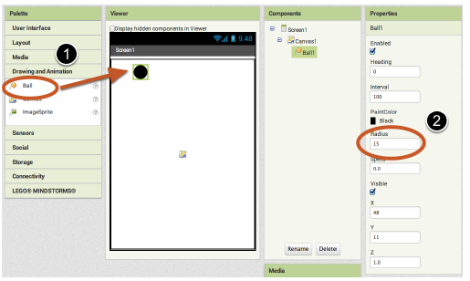
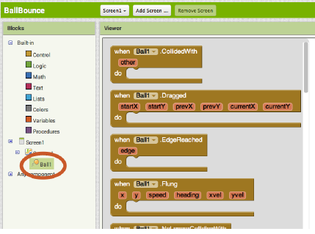
Ball Bounce
Images Sourced: http://appinventor.mit.edu/explore/sites/all/files/hourofcode/BallBounceTutorial_2perpage.pdf
Add a Ball to your App!
Use the Design Editor to change the colour and size (radius) of the ball.
Use the Block Editor to add some action blocks / behaviours for the Ball.

Slide 16
Island Connection Challenge
Image Source: http://www.pixabay.com
Notes:
Let’s see if we can write an algorithm to find the best way for a tour operator to travel between a network of tropical islands!

Slide 17
Minimal Spanning Trees
Notes:
People who build networks need to work out the most efficient way to make connections. Connecting everything to a network once, and in the most efficient way, is often labelled as the “minimum spanning tree” of a network.
This is a very important area of computer science, and something algorithms can assist with.
The image on the slide represents a network, with each of the circles an item in the network, and each of the arrows a connection. When we remove the red arrows, each circle is only connected to the network once, and by the shortest arrows possible. The blue arrows are the minimum spanning tree of the network in this case.
Many of the algorithms created to find the minimal spanning tree of a network are called ‘greedy’ algorithms. Greedy algorithms build up a solution piece by piece, always choosing the next piece that offers the most obvious and immediate benefit.

Slide 18
The Challenge
You and your friends have just moved to a tropical paradise, a small group of islands in the middle of the ocean!
You will be opening a tour boat company, “Island Connections”, taking tourists between the islands.
Before opening day, you need to find the “best”, cheapest way to visit all of the islands by boat.
Because you are new to the islands, you don’t know all the possible sailing routes between them, so you must discover these first!

Slide 19
Rules
You will need to work in pairs (with your tour company partner!) to discover the “best”, cheapest way to visit all islands.
You will be given a map of the islands, and information on the possible sailing routes between them to help you. There are a total of 7 islands.
You will need to discover all of the different sailing routes between the islands and draw them on your map. Each route will have a different cost.
You may begin sailing from any island!
You may only move between islands using the known sailing routes. Each island has 2 or 3 possible routes to choose from.
You may choose one route from each island at a time.

Slide 20
Note!
Running is not allowed on the boats! No running between islands, only sailing!
Points will be awarded for teamwork
Points will be awarded for having a complete map of all routes between islands
Points will be awarded for discovering the “minimum spanning tree” of the tropical paradise

Slide 21
Legend:
Route A
Route B
Route C
Diagram of all known route options and costings between Islands
Long Island
RA = $3, RB = $2
Shop Island
RA = $1, RB = $5, RC = $5
Sun Island
RA = $3, RB = $1, RC = $4
Penguin Island
RA = $3, RB = $5
Delivery Island
RA = RB = RC $5
Scarecrow Island
RA = $1, RB = $2, RC = $4
Treasure Island
RA = $3, RB = $1

Slide 22
Prims Algorithm
Prims Algorithm is one algorithm which can be used to find the minimum spanning tree of a map.
It is a greedy algorithm… this means that it builds the minimum spanning tree step-by-step, looking for the ‘best’ connection each time!
Notes:
You may have found the spanning tree already using a different method. But prims algorithm always works. It is sometimes used by computers for larger scale maps. Imagine if you had 100 Islands to connect your route too! Let’s take a look at how it works.

Slide 23
Diagram of “minimum spanning tree” (seeking lowest cost)
using ‘Prims Algorithm’
…and starting at Shop Island.
Legend:
Route A
Route B
Route C
Long Island
RA = $3, RB = $2
Shop Island
RA = $1, RB = $5, RC = $5
Sun Island
RA = $3, RB = $1, RC = $4
Penguin Island
RA = $3, RB = $5
Delivery Island
RA = RB = RC $5
Scarecrow Island
RA = $1, RB = $2, RC = $4
Treasure Island
RA = $3, RB = $1
Notes:
Example Solution using Prims Algorithm
Step 1: Choose an Island to begin with, lets choose Shop Island… If we are on Shop Island, we now need to look see what the cheapest route or “best” Island to connect to is from Shop Island. Who can tell me? It’s Route A (RA) to Scarecrow Island ($1). Step 2: Now, we are still on Shop Island and we also have 1 connection to Scarecrow Island.
So we now look for the “best” or cheapest route from either Shop Island or Scarecrow Island. Which is it? In this case, it’s Route B from Scarecrow Island to Long Island ($2).
Step 3: Now we have 2 islands with connections to Shop Island!
So next, we need to look at Shop Island, Scarecrow Island and Long Island, to see which is the best or “cheapest” route to any of the remaining islands we haven’t connected to yet! Who can see what it is? It is Route B (RB) from Long Island to Penguin Island ($2).
Step 4: Now we have 3 islands connected to Shop Island. Can anyone tell me which route to take to connect the 4th Island?
It’s Route C from Scarecrow Island, over to Sun Island ($3).
Step 5: We now have connections to Shop Island, Scarecrow Island, Long Island, Penguin Island and Sun Island.
The next cheapest route is…. Route B Sun Island to Treasure Island ($1).
Step 6: We now have connections to 6 islands! Shop Island, Scarecrow Island, Long Island, Penguin Island, Sun Island and Treasure Island.
The next cheapest route to the final, 7th Island is… Route B from Shop Island to Delivery Island ($5).
The yellow lines represent the minimum spanning tree using Prims Algorithm, searching for the lowest cost, starting at Shop Island. If we started at a different island, the tree would most likely look different. If we were to repeat the challenge looking for the shortest distance, the minimal spanning tree might look different again.

Slide 24
References
MIT App Inventor
This session uses MIT’s App Inventor as well as links to some of its resources.
http://appinventor.mit.edu/explore/
MIT’s App Inventor and resources are licensed under a Creative Commons Attribution-ShareAlike 3.0 Unported License
© 2012-2017 Massachusetts Institute of Technology
CS Unplugged http://csunplugged.org/
Code.org https://code.org./
21 Card Trick http://kidsentertainerhub.com/the-21-card-trick/
Algorithms
https://www.theguardian.com/science/2013/jul/01/how-algorithms-rule-world-nsa
http://www.geeksforgeeks.org/greedy-algorithms-set-5-prims-minimum-spanning-tree-mst-2/
https://en.wikipedia.org/wiki/Bubble_sort

